Slide 1
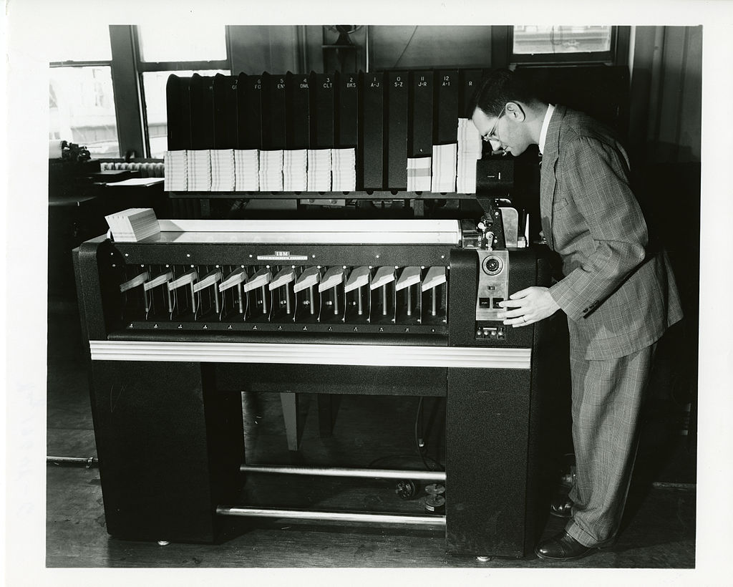
Foundations of Sorting Algorithms
Omkar Deshpande
http://ai.stanford.edu/~omkard/
(Some slides have been taken from CS161 @Stanford, Sedgewick book on Algorithms, and CS130 @ IIT Delhi)

Slide 2
Overview
Why Sorting?
Algorithm design strategies
Brute force (Monkey Sort, Selection Sort, Bubble Sort)
Decrease-and-conquer (Insertion Sort)
Divide-and-conquer (Merge Sort, Quick Sort)
Transform-and-conquer (Tree Sort, Heap Sort)
3. Linear-time sorting (Radix Sort, Counting Sort, Bucket Sort)
Along the way, learn how to analyse algorithms in general (time and space) for their performance.

Slide 3
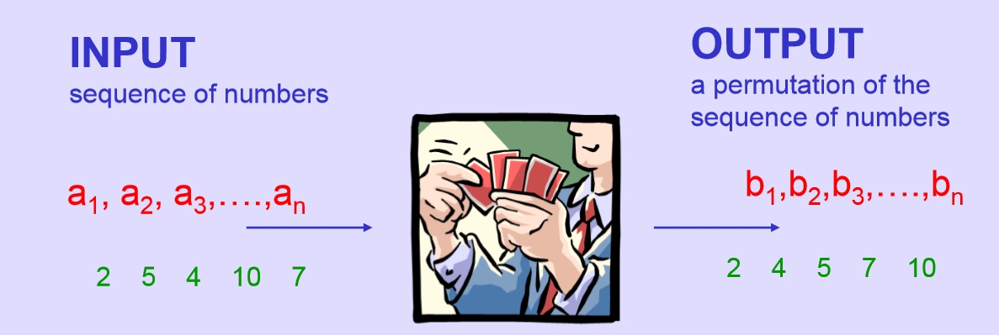
Sorting problem definition

Slide 4

“Computer manufacturers of the 1960s estimated that more than 25% of the running time on their computers was spent on sorting… in fact, there were many installations in which the task of sorting was responsible for more than half of the computing time.” (Donald Knuth, The Art of Computer Programming, Vol 3)

Slide 5
Applications
Searching for a value is faster in a sorted array than an unsorted array.
Can find duplicates easily using sorting (all items with equal value appear in consecutive positions).
Matching items in two or more files.
Can find median and top k values quickly.
The truncated top of an immense sorted list is the universal UI.

Slide 6
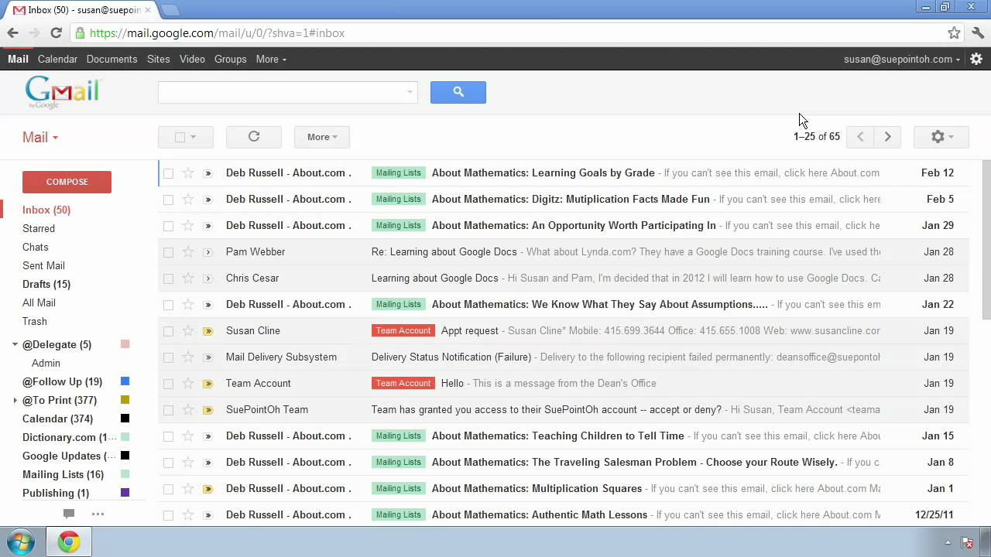

Slide 7
Other benefits
Sorting provides a valuable case study of how to attack programming problems in general. E.g, algorithm design strategies like “Decrease and conquer”, and “Divide and conquer”.
Sorting provides an excellent illustration of how to analyse algorithms to determine their performance, so that you can then choose between competing methods.

Slide 8
Internal Sorting
Memory locations A, A+1, A+2, A+3, ….. A+(n-1) contain n numbers. Write a computer program that rearranges these numbers, if necessary, so that they are in ascending order.

Slide 9
Design strategy 1: Brute force
Simplest design strategy
The most straightforward approach, usually based on the problem statement.

Slide 10
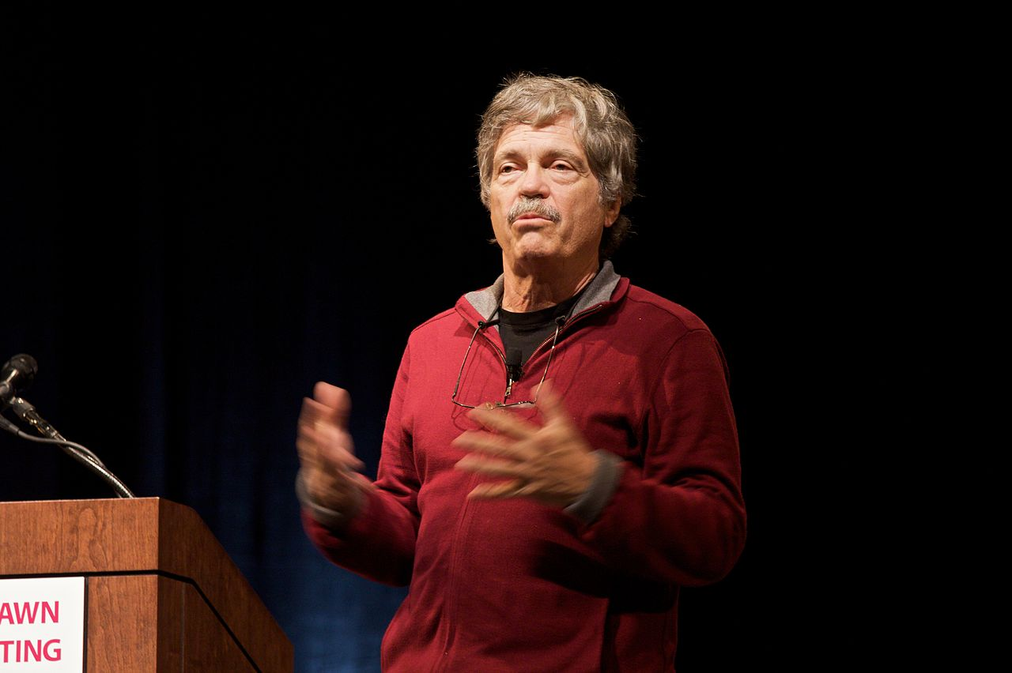
“Most software today is very much like an Egyptian pyramid with millions of bricks piled on top of each other, with no structural integrity, but just done by brute force and thousands of slaves.” (Alan Kay, ACM Turing Award 2003)

Slide 11
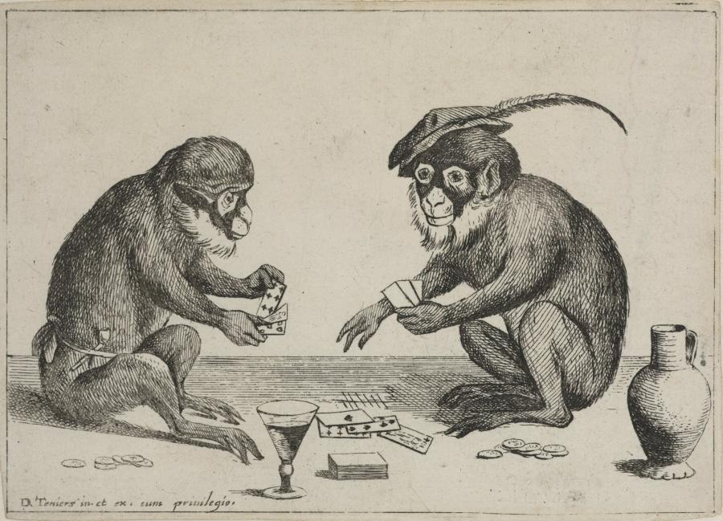
Monkey Sort / Stupid Sort / Bogo Sort
while not Sorted(list) do
shuffle (list)
done
Is this a good algorithm?
Notes:
https://www.boijmans.nl/en/collection/artworks/37263/two-monkeys-playing-cards

Slide 12

Correctness and Efficiency
The algorithm appears to be correct.
But even if we had a machine that could run 10⁸ operations per second, and even if we could generate and test one permutation in a single operation, we would need almost 800 years for an array of size 20.
For an array of size 100, it would take 10¹⁴² years.

Slide 13
A better brute force algorithm
Locate the smallest item and put it in the first place.
Then select the next smallest item and put it in the second place. And so on…
Sorting by repeated selection: “Selection Sort”
Final output ordering generated one by one in sequence.

Slide 14
A brute force algorithm
Locate the smallest item and put it in the first place.
Then select the next smallest item and put it in the second place. And so on…
Sorting by repeated selection: “Selection Sort”
Final output ordering generated one by one in sequence.

Slide 15
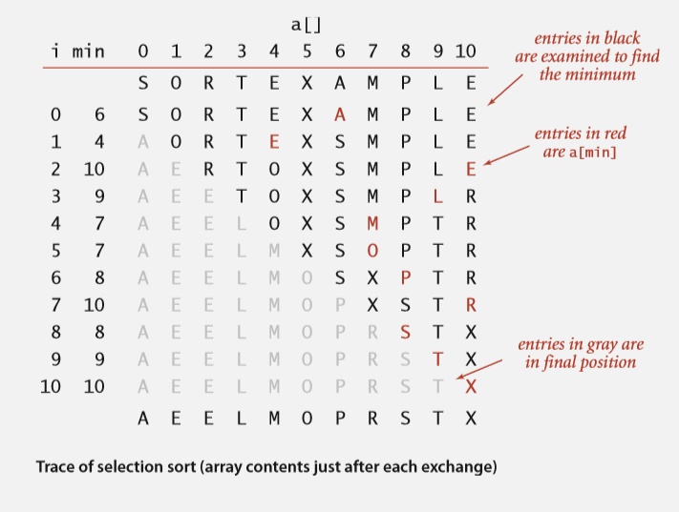

Slide 16
Selection Sort
function selectionsort(A): //array A[1..n]
for i in 1 to n:
#Find the i^{th} smallest element and swap it with A[i]
min = i
During a linear scan of A[i..n]:
if you find a smaller element than A[min]:
Update the index of the min element
Swap the min element with A[i]
How do we analyse this algorithm?

Slide 17
Selection Sort
def selectionsort(a):
for i in range(len(a)):
#Find the i^{th} smallest element and swap it with a[i]
min = i
for inner in range(i, len(a)):
if a[inner] < a[min]:
min = inner
(a[i],a[min]) = (a[min],a[i])
How do we analyse this algorithm?

Slide 18
What does it mean to analyse an algorithm?
Establish its correctness.
Quantify its “efficiency”.
Time: How long does the algorithm take to run? (“Running time”)
Space: How much memory does the algorithm use to run?
Why is running time given more importance than space?
Running time depends on speed of the processor, which is not easy to change.
Memory is easier to augment.

Slide 19
How do we measure running time?
We can code up the algorithm as a program, and run it on a machine. Measure how much time (in seconds) it takes to run.
But that value would be different for different machines. It may be different for different programming languages. It may be different for different inputs.
Better to focus on system-independent factors here, and leave system-dependent factors to the experts.

Slide 20
Input size clearly matters, and is system-independent
A larger array will take a longer time to sort.
So why not define running time as a function of input size ?
T(n): where n is the input size.
How do we compute an expression for T(n) in terms of n?

Slide 21
How do we measure running time?
For an input of size n, measure running time of the algorithm as the “number of basic operations” in the pseudocode, in a way that it can be ‘counted’ even before writing it as a program.

Slide 22
How do we measure running time?
Number of basic operations in a high-level language. Examples of basic operations, with a fixed execution time, but different constant values for each:
hours_until_dinner = 2 //Variable assignment
class_end_time = t + 2.5 //Simple arithmetic operation on a variable
s = “Hope you are not already feeling sleepy!” //Variable assignment
if (sleeping_time < class_end_time) then print “Watch recording later” //Slightly longer basic operation

Slide 23
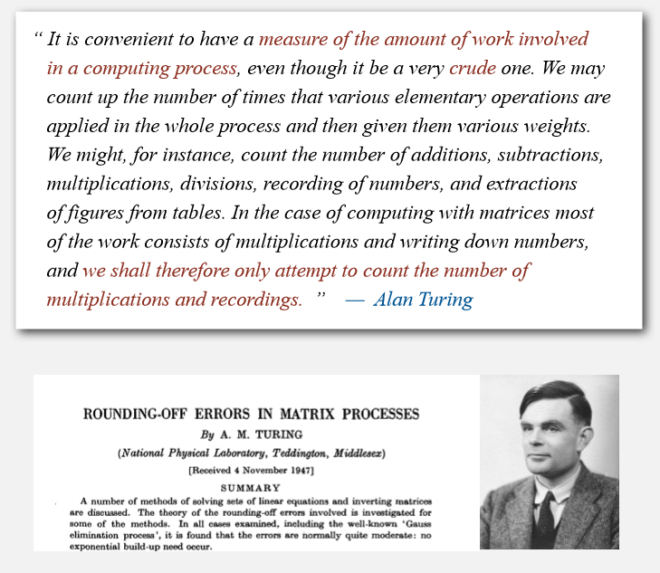

Slide 24
Two basic operations in sorting algorithms
These would dominate the running time.
Comparison: if a[inner] < a[min]:
Exchange/Swap: (a[i],a[min]) = (a[min],a[i])

Slide 25
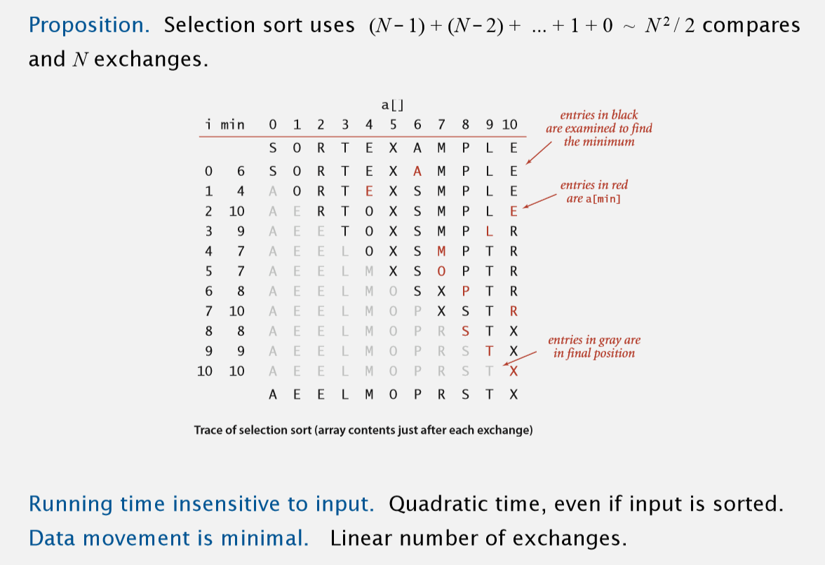

Slide 26
Running time expression for selection sort
c₁*N²/2 + c₂*N + c₃

Slide 27
Running time expression for selection sort
c₁*N²/2 + c₂*N + c₃
Which term dominates as N becomes large?

Slide 28
Running time expression for selection sort
c₁*N²/2 + c₂*N + c₃
Which term dominates as N becomes large?
The first term. So let’s drop the lower-order terms. To make the analysis system-independent, we also ignore the constant factors.
The asymptotic complexity becomes O(N²)

Slide 29
A variation of the brute force algorithm
To get the minimum elements one by one, we scanned the array from left to right and kept track of the next minimum.
Instead, we could have scanned the array from right to left, and bubbled up the minimum to the left by repeated exchanges.
Repeat n times:
While scanning the array from right to left:
if A[i-1] > A[i], swap them

Slide 30
def bubblesort(a):
for start in range(len(a)):
for i in range(len(a)-1,start,-1):
if a[i-1] > a[i]:
(a[i-1],a[i]) = (a[i],a[i-1])

Slide 31

“I think the bubble sort is the wrong way to go”

Slide 32
Running time expression for bubble sort
c₁*N²/2 + c₂*N + c₃
The asymptotic complexity becomes O(N²)

Slide 33
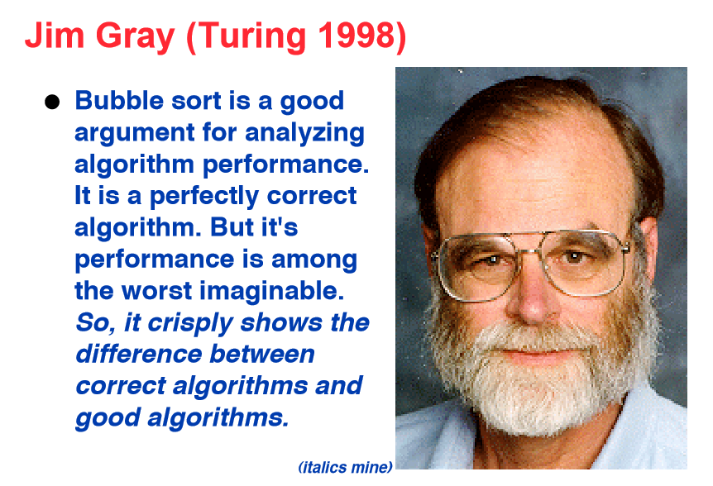

Slide 34
Design strategy 2: Decrease-and-conquer
Decrease the problem of size n to size n-1
Assume you have solved the problem of size n-1
Solve the problem of size n using the solution to the problem of size n-1
Recursive (if top-down) and iterative (if bottom-up)

Slide 35
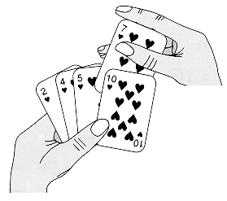

Slide 36
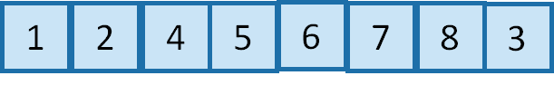

Slide 37
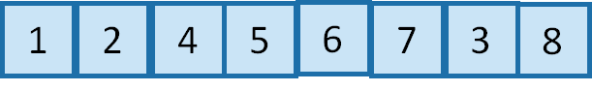

Slide 38
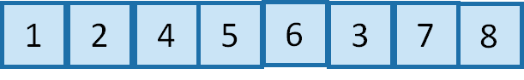

Slide 39
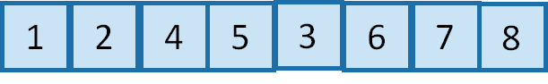

Slide 40
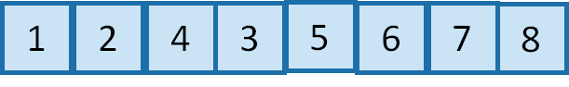

Slide 41
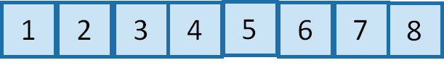

Slide 42
def insertionsort(A,n): //array A[1..n]
if (n <= 1) return;
insertionsort(A,n-1);
//now insert the nth element into its place. j = n-1
while j >= 1 and A[j] > A[j+1]:
swap(A[j+1],A[j]) j = j - 1
return
Recursive version
(Top-down)

Slide 43
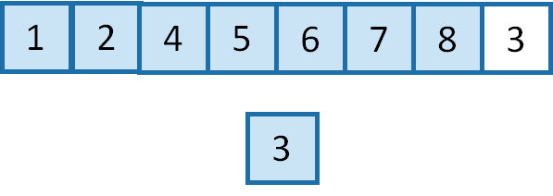

Slide 44
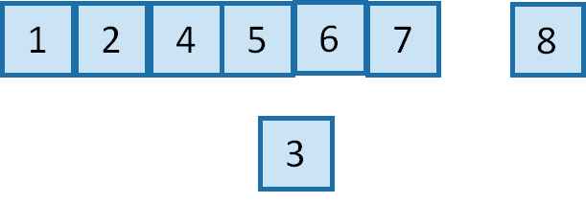

Slide 45
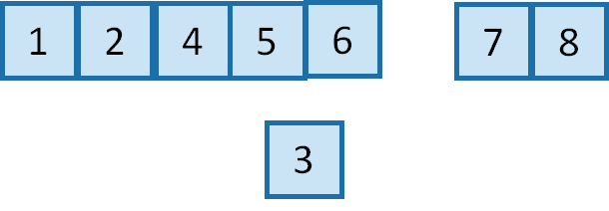

Slide 46
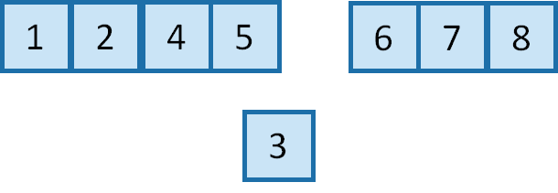

Slide 47
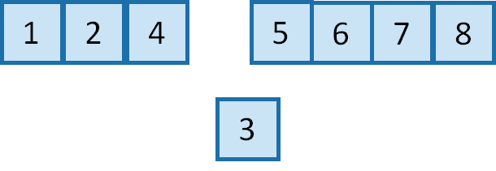

Slide 48
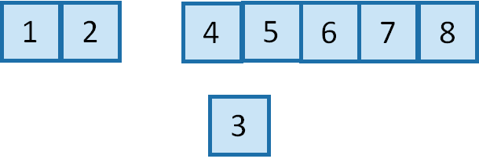

Slide 50
def insertionsort(A,n): //array A[1..n]
if (n <= 1) return;
insertionsort(A,n-1);
//now insert the nth element into its place. nth = A[n] j = n-1
while j >= 1 and A[j] > nth:
A[j+1] = A[j] j = j - 1
A[j+1] = nth
return
Slightly more efficient: shift elements to right instead of swapping repeatedly

Slide 51
def insertionsort(A): //array A[1..n]
if (n <= 1) return;
for i = 2 to n: ith = A[i] j = i-1
while j >= 1 and A[j] > ith:
A[j+1] = A[j] j = j - 1
A[j+1] = ith
return
Iterative version (bottom-up)

Slide 52
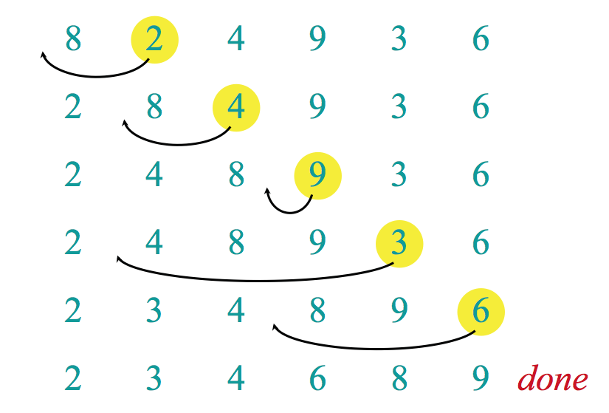

Slide 53
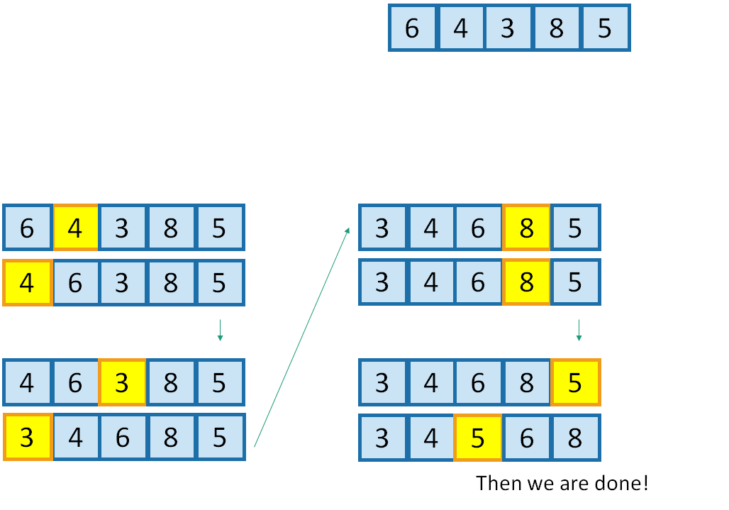

Slide 54
def insertionsort(A,n): //array A[1..n]
if (n <= 1) return;
insertionsort(A,n-1);
//now insert the nth element into its place. nth = A[n] j = n-1
while j >= 1 and A[j] > nth:
A[j+1] = A[j] j = j - 1
A[j+1] = nth
return
Time complexity T(n) = ?
T(n-1)
}
c₁*(#shift operations)
Remaining lines = c₂

Slide 55
def insertionsort(a):
if len(a) < 2:
return
for i in range(1,len(a)):
j = i-1
curr_element = a[i] #Find the right spot for it
while j >= 0 and curr_element < a[j]:
a[j+1] = a[j]
j -= 1
a[j+1] = curr_element

Slide 56
T(n) = T(n-1) + c₁*(#shift operations) + c₂
T(n) = ∑ [c₁*(#shift operations for i^{th} number) + c₂]
(Recursive)
(Iterative)
n
i = 1

Slide 57
#shift operations for i^{th} number could be
As small as 0 (best-case)
As large as i (worst-case)
On average i/2 (average-case)

Slide 58
Not only input size but nature of input clearly matters
We defined running time T(n) as a function of input size n.
But now we see that for the same input size n, there can be a variety of running times, depending on the nature of the input array.
What if we took the maximum of all of them?
T(n) = Worst-case running time for input of size n.
What if we took their average?
T(n) = Average-case running time for input of size n.
We can also define a best-case running time, but it is not useful.

Slide 59
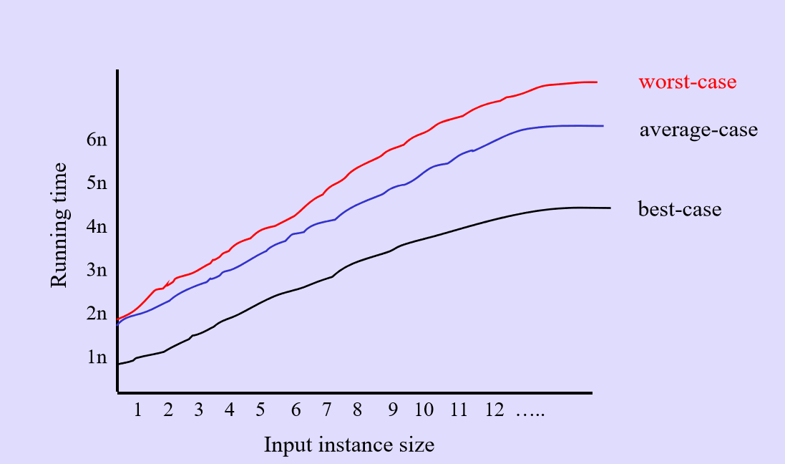

Slide 60
Time complexity of insertion sort
Worst-case = O(n²)
Average-case = O(n²)
Best-case = O(n)

Slide 61
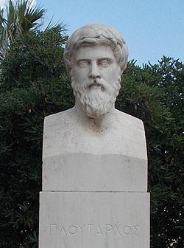
“He (Sertorius) called a general assembly and introduced before it two horses, one utterly weak and already quite old, the other large-sized and strong, with a tail that was astonishing for the thickness and beauty of its hair. By the side of the feeble horse stood a man who was tall and robust, and by the side of the powerful horse another man, small and of a contemptible appearance. At a signal given them, the strong man seized the tail of his horse with both hands and tried to pull it towards him with all his might, as though he would tear it off; but the weak man began to pluck out the hairs in the tail of the strong horse one by one. (Plutarch, The Parallel Lives)

Slide 62
Decrease-and-conquer > Brute force
The strong man gave himself no end of trouble to no purpose, made the spectators laugh a good deal, and then gave up his attempt; but the weak man, in a trice and with no trouble, stripped his horse's tail of its hair. Then Sertorius rose up and said: "Ye see, men of my allies, that perseverance is more efficacious than violence, and that many things which cannot be mastered when they stand together yield when one masters them little by little. (Plutarch, The Parallel Lives)

Slide 63
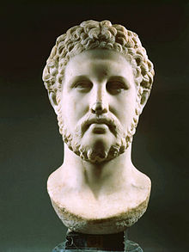
“Divide and rule” (attributed to Philip II of Macedon)

Slide 64
Design strategy 3: Divide-and-conquer
Divide the problem into several smaller instances of the problem (most often two), generally of same size
Solve the smaller instances (typically using recursion)
Combine the solutions to the smaller instances to get the solution to the original problem.

Slide 65
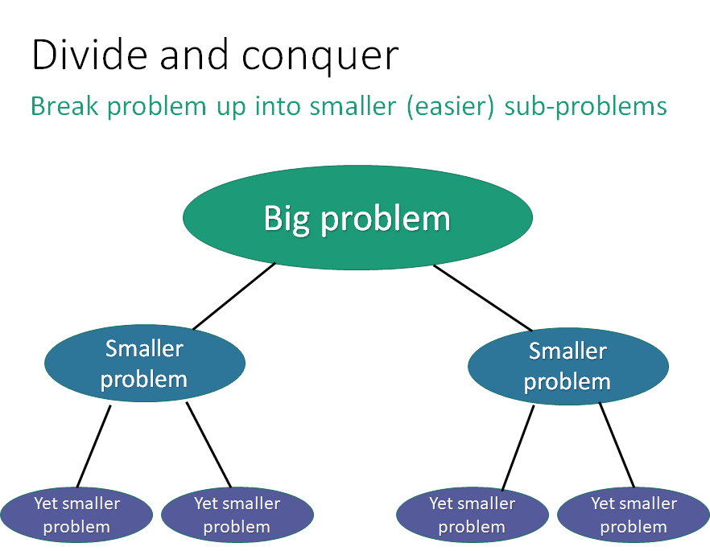

Slide 66
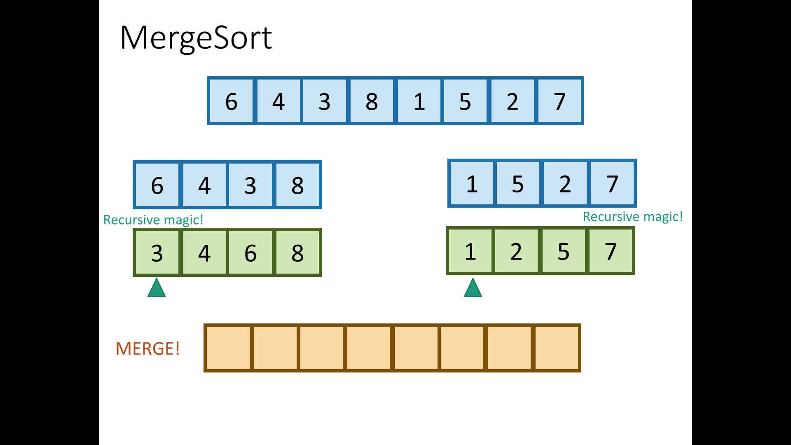

Slide 67
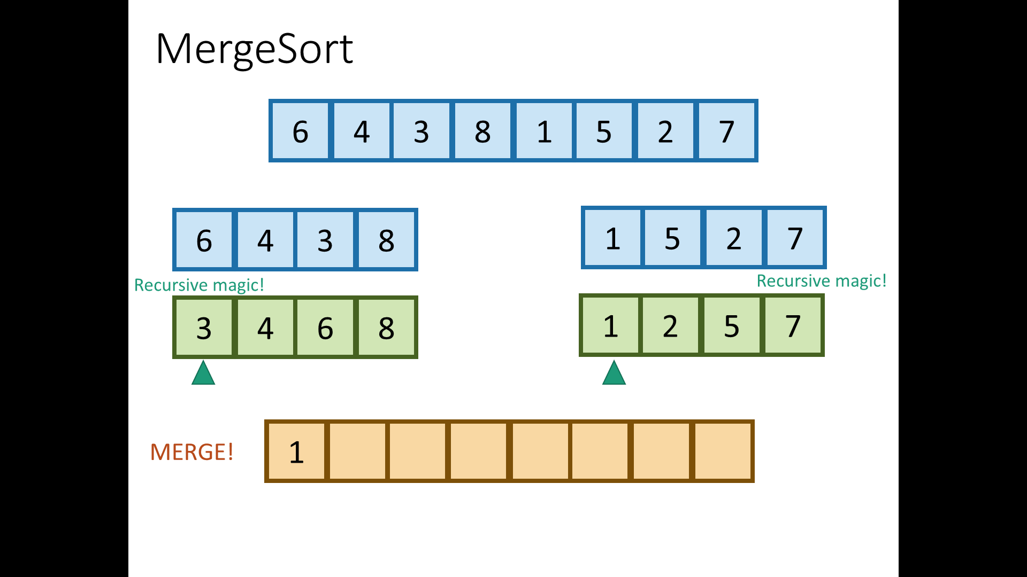

Slide 68
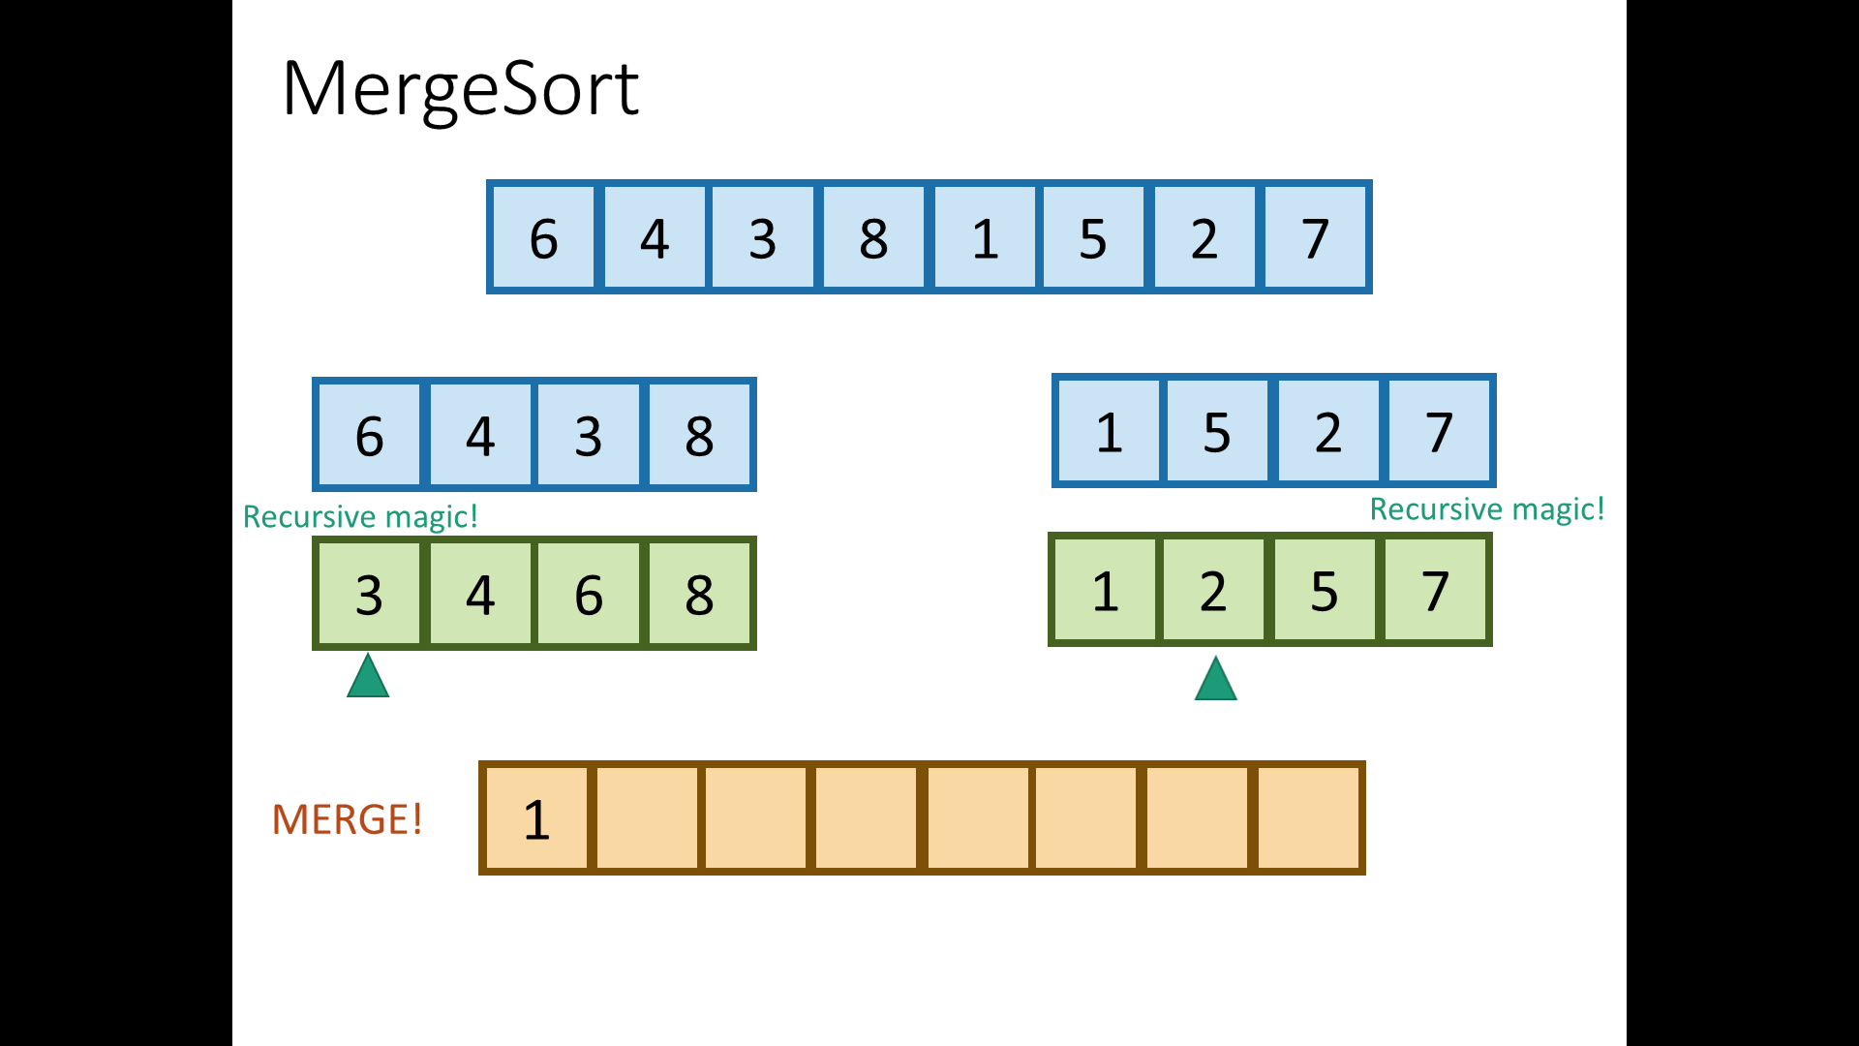

Slide 69


Slide 70
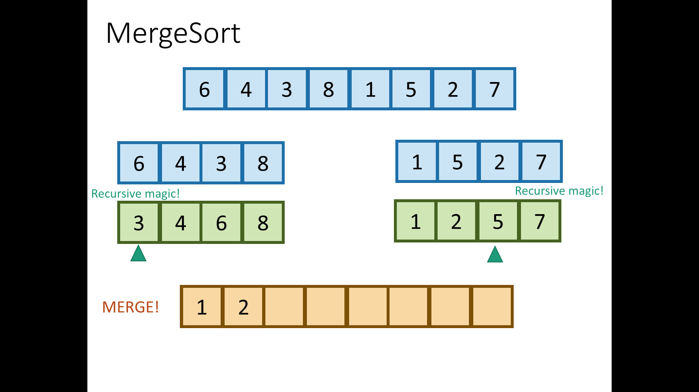

Slide 71


Slide 72
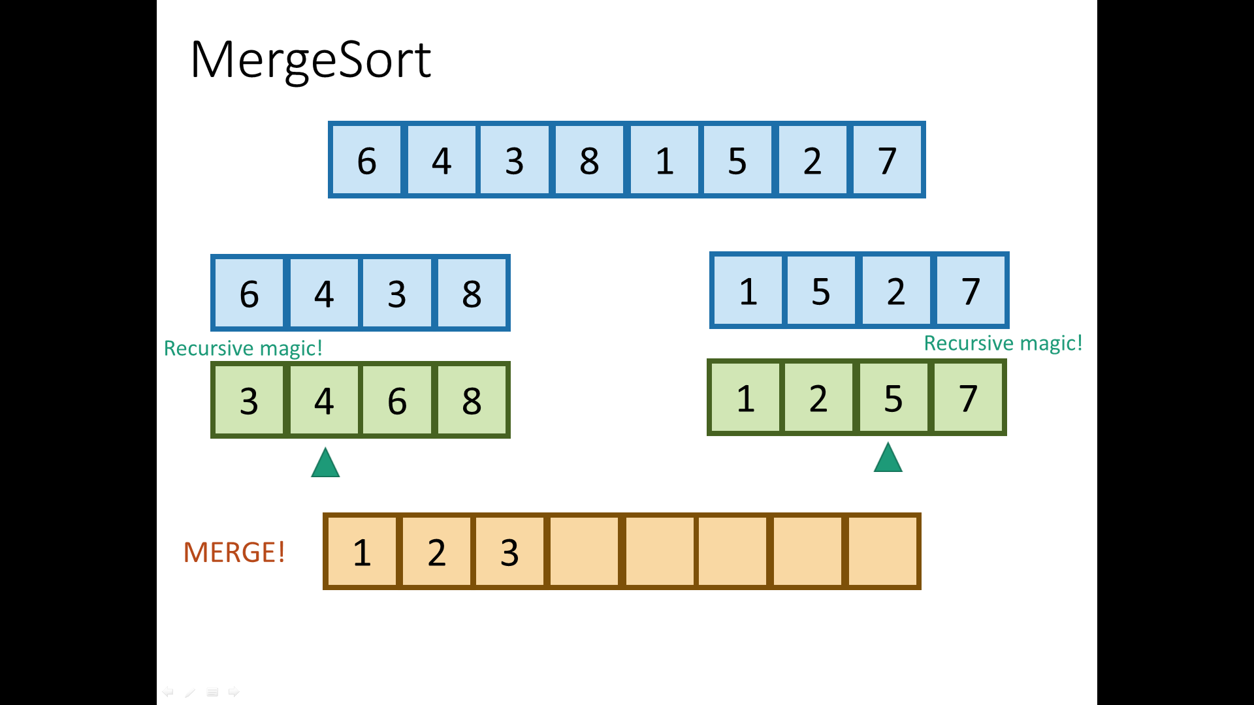

Slide 73


Slide 74


Slide 75


Slide 76
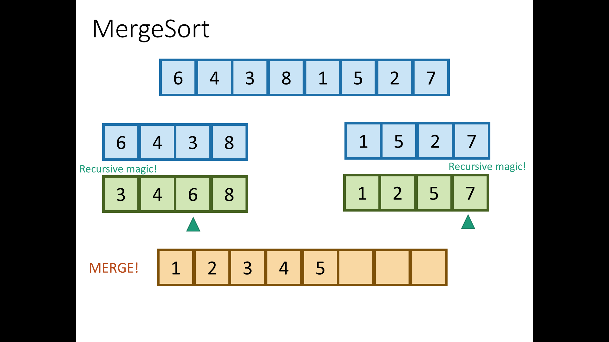

Slide 77
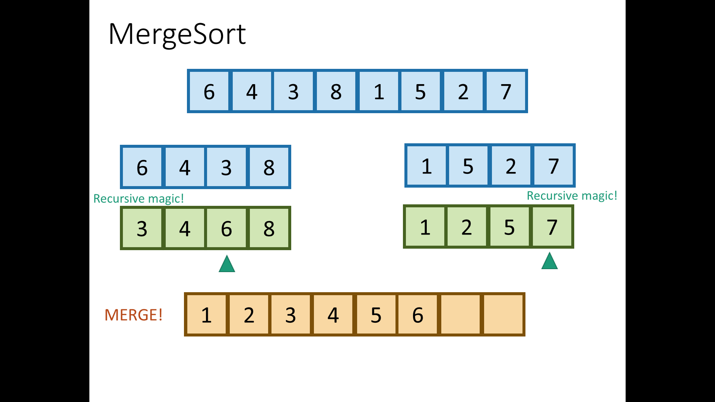

Slide 78
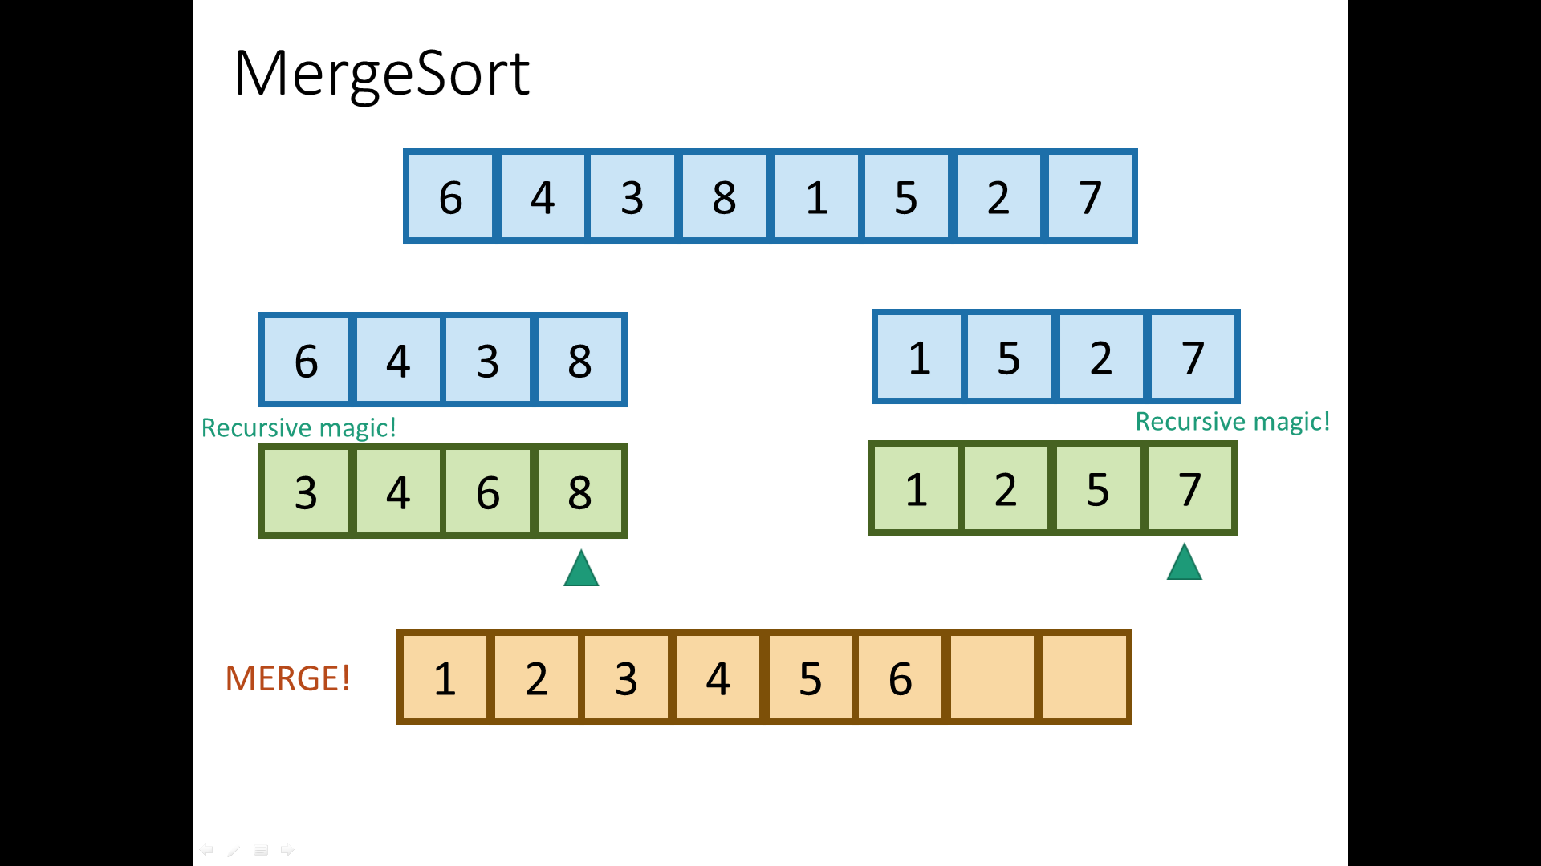

Slide 79
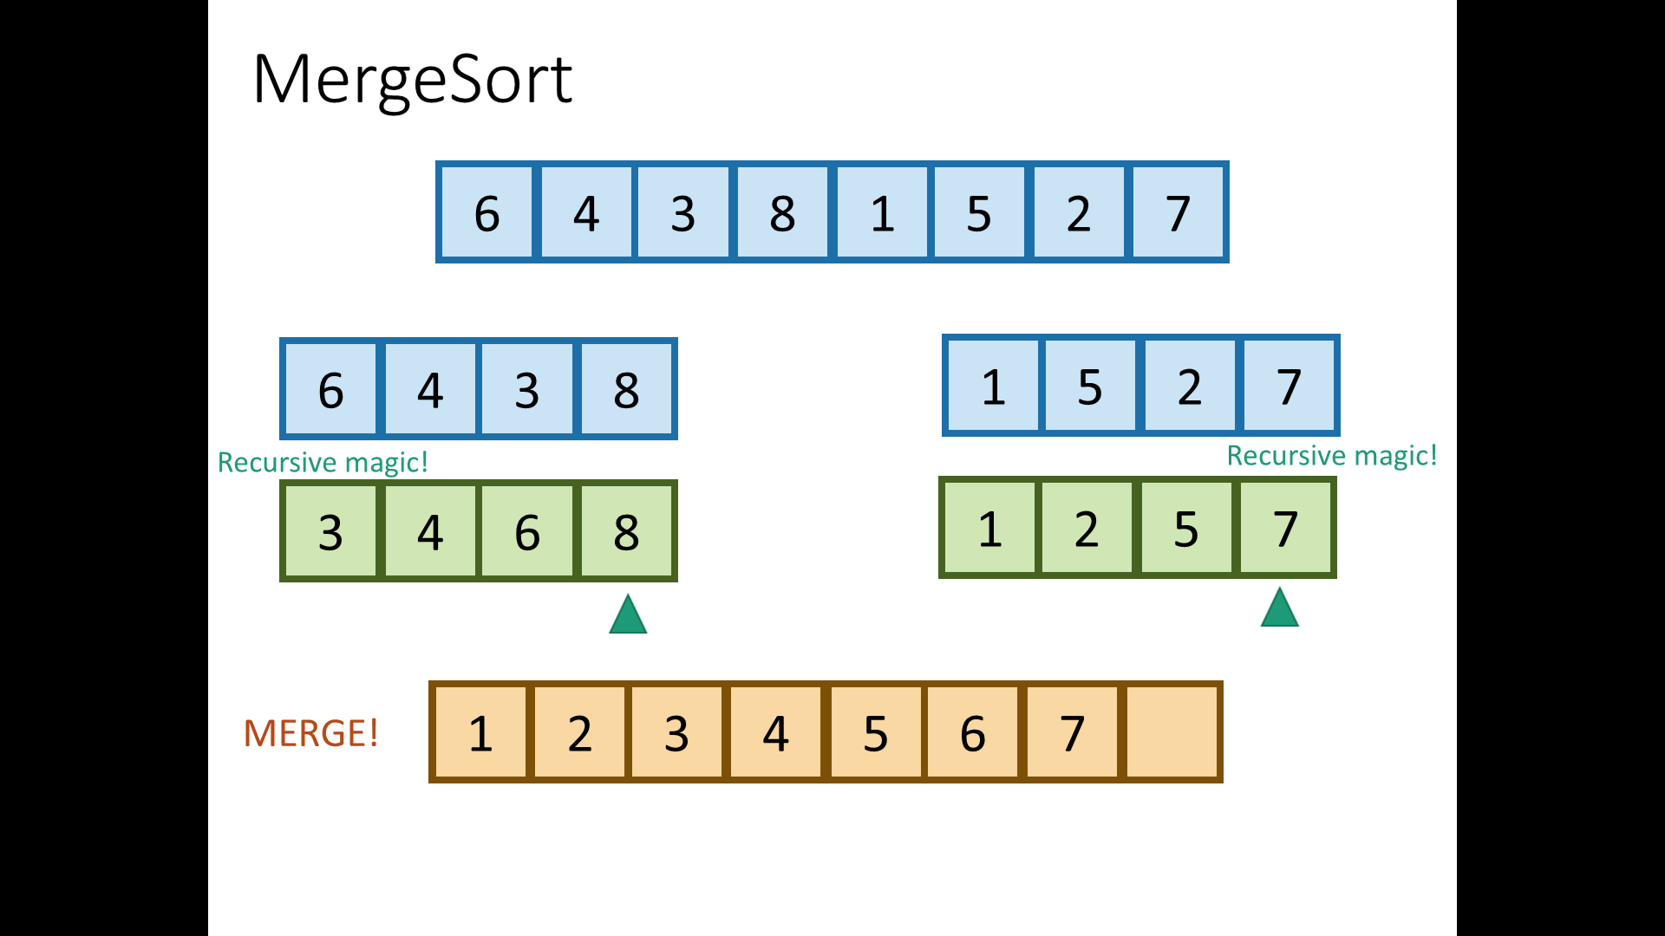

Slide 81
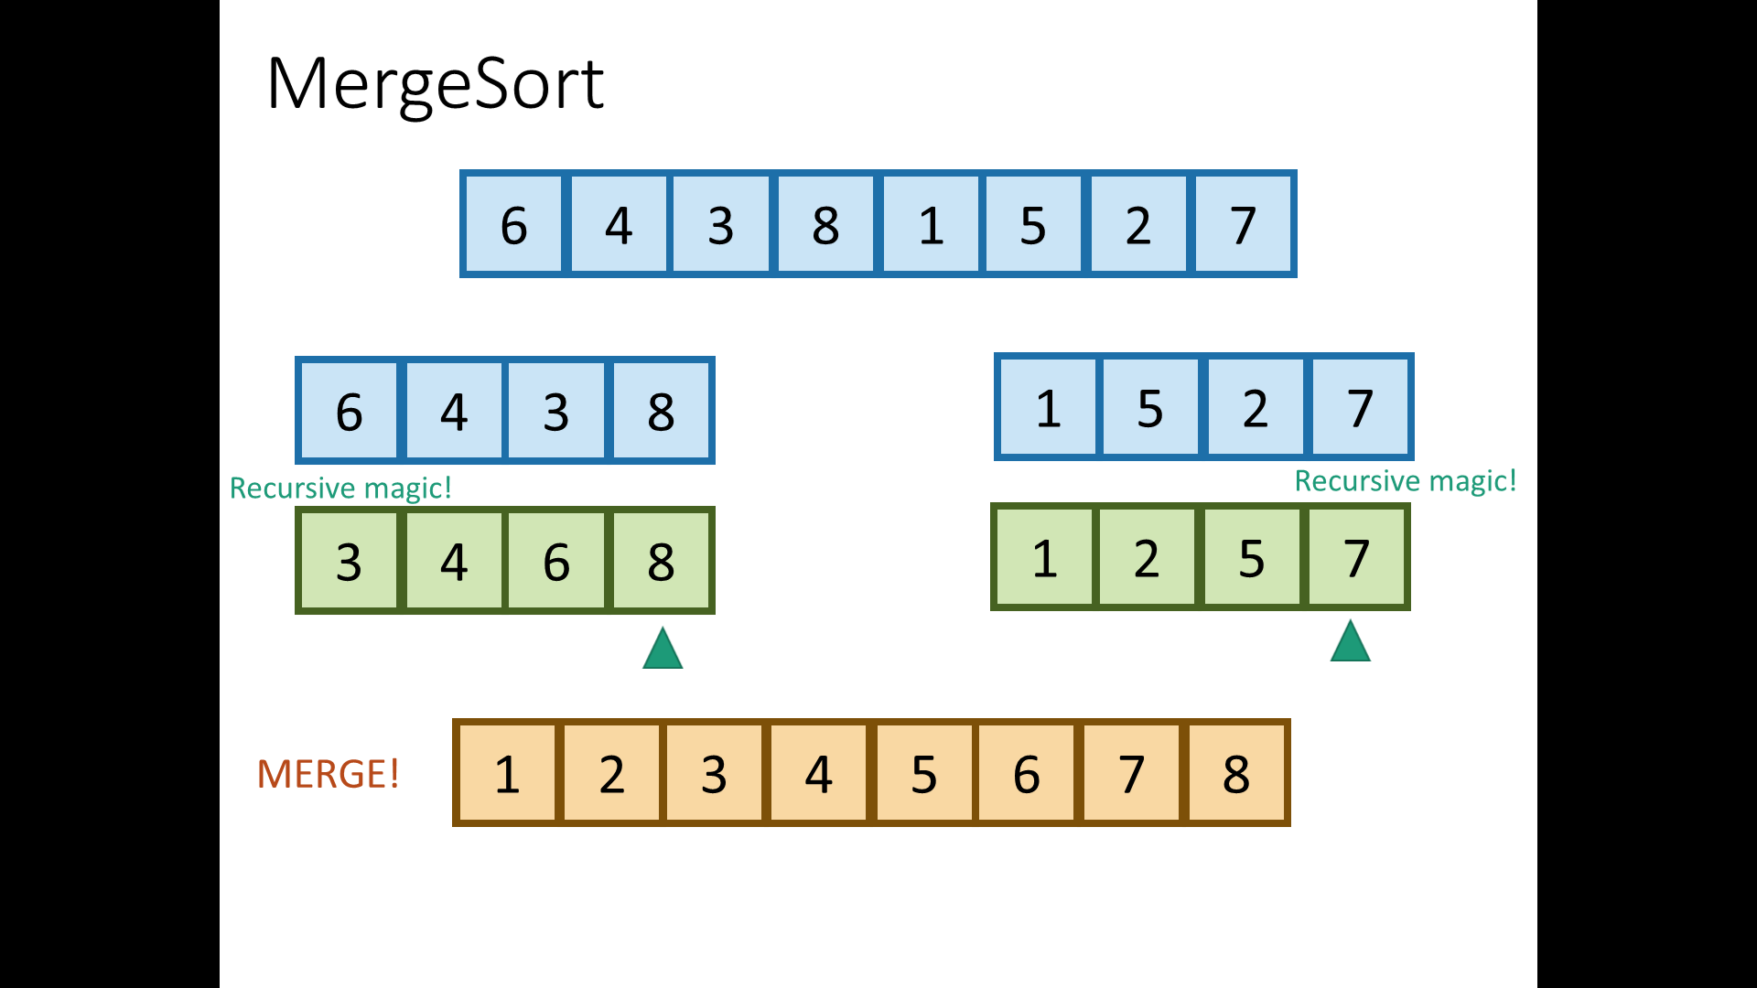

Slide 82
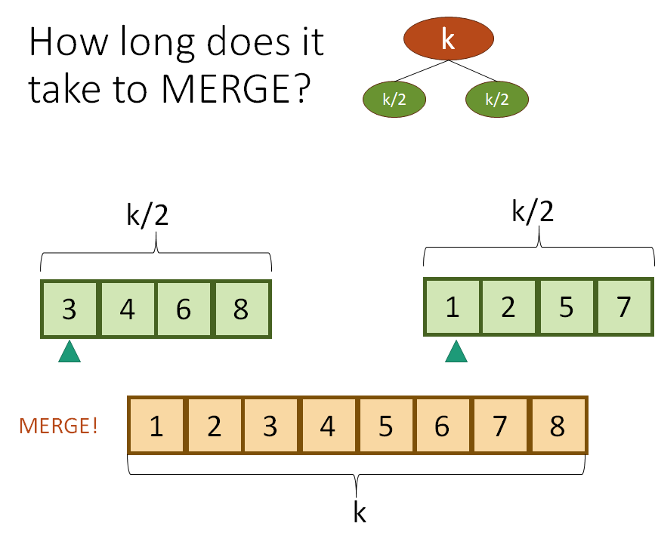

Slide 83
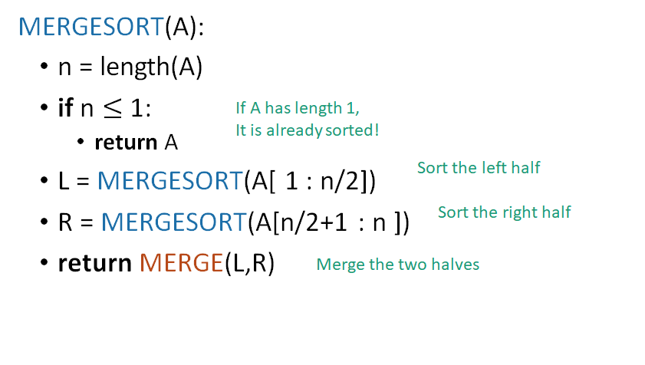
Partitioning based on position

Slide 84
def msort(l, start, end):
if start >= end:
return
mid = (start + end)/2
msort(l, start, mid)
msort(l, mid+1, end)
i = start
j = mid+1
mlist = []
while i <= mid and j <= end:
if l[i] <= l[j]:
mlist.append(l[i])
i += 1
elif l[j] < l[i]:
mlist.append(l[j])
j += 1
while i <= mid:
mlist.append(l[i])
i += 1
while j <= end:
mlist.append(l[j])
j += 1
l[start:end+1] = mlist
def mergesort(a):
msort(a, 0, len(a)-1)
#Now merge the two sorted subarrays l[start...mid] and l[mid+1...end]

Slide 85
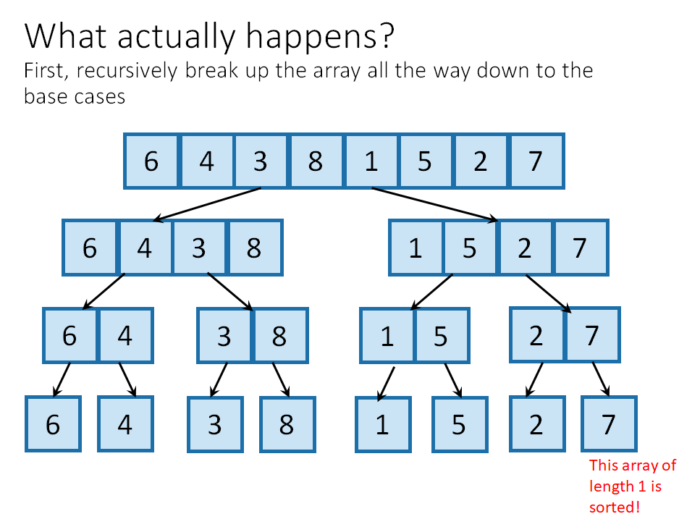

Slide 86
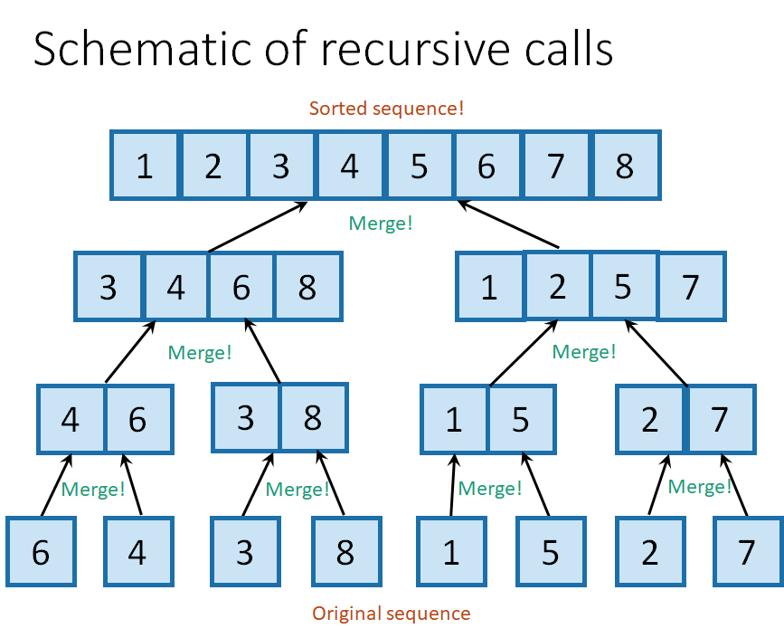
T(n) = 2T(n/2) + cn

Slide 87
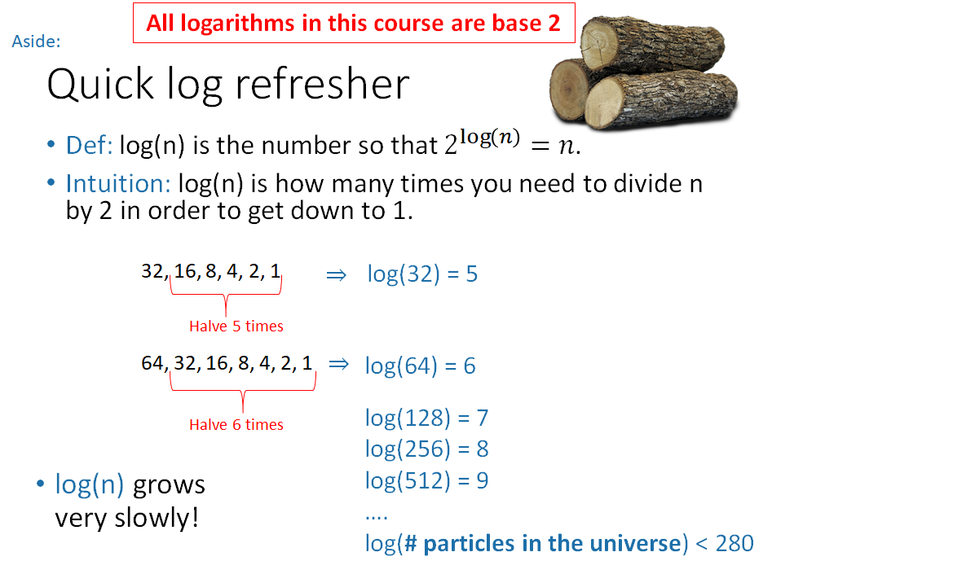

Slide 88
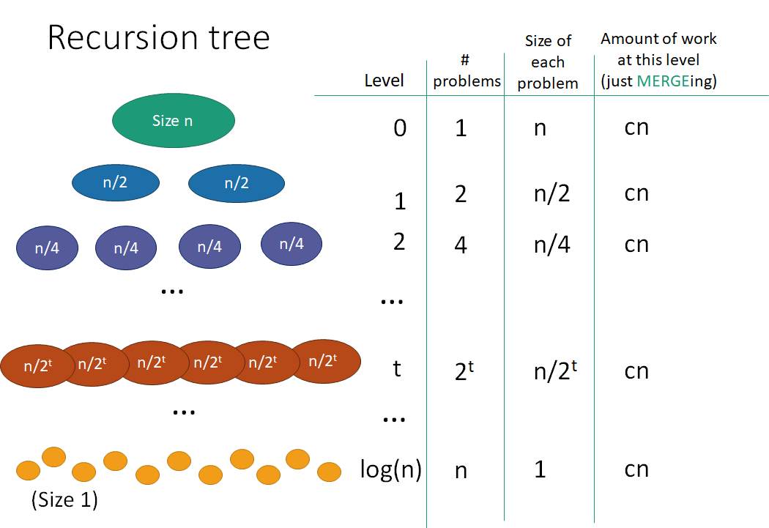

Slide 89
Time complexity
Merge Sort: O(n log n)
Worst-case? Best-case? Average-case?
Recall:
Insertion Sort: Worst-case and average-case, O(n²), best-case O(n) Selection Sort and Bubble Sort: O(n²)

Slide 90

TimSort
Combines merge-sort and insertion-sort for worst-case O(n log n) time and best-case O(n) time.
Timsort has been Python's standard sorting algorithm since version 2.3
Tim Peters

Slide 91
How important is the distinction between n log n and n²?
US population = 320 million
Suppose we had to sort census data based on names.
Assume that a CPU can perform 100 million basic operations per second (10⁸).
Executing n log n operations would take ~90 seconds or 1.5 minutes.
Executing n² operations would take 32.5 years!

Slide 92
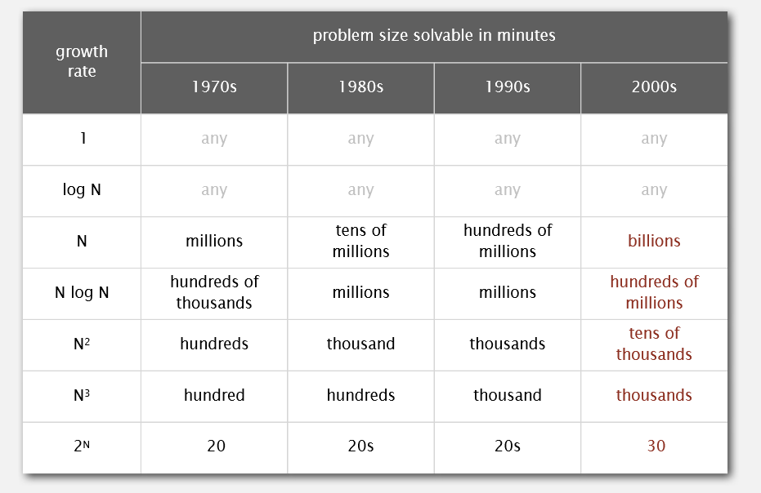

Slide 93
Merge sort requires extra memory
An algorithm is said to be in place if it does not require extra memory, except a constant amount of memory units.
Is merge sort in place?
Insertion sort? Selection sort? Bubble sort?

Slide 94
Design strategy 3: Divide-and-conquer
Recall:
Divide the problem into several smaller instances of the problem (most often two), generally of same size
Solve the smaller instances (typically using recursion)
Combine the solutions to the smaller instances to get the solution to the original problem.

Slide 95
Merge Sort
Divide the array into two subarrays, based on position (trivial).
Solve the problem on the smaller subarrays by recursively sorting them.
Combine the two sorted subarrays by merging them together (took “cn” work, and extra space)

Slide 96
≤ value
> value
Divide the array into two subarrays, based on value. (this will take some work)
Solve the problem on the smaller subarrays by recursively sorting them.
Combine the two sorted subarrays by merging them together (trivial)

Slide 97
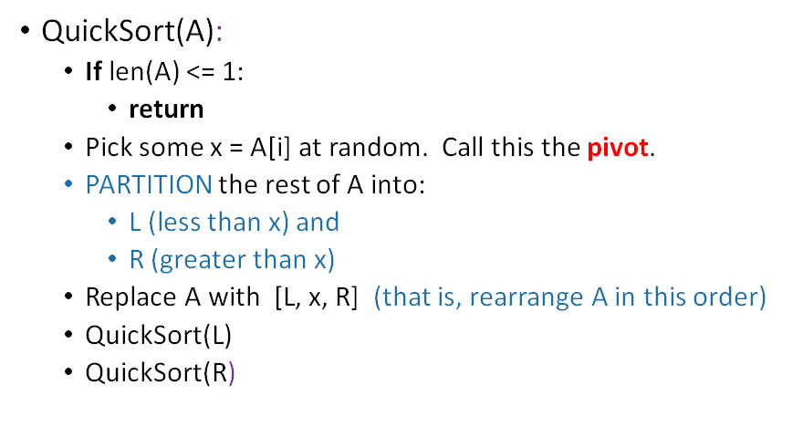
L
x
R
< value
value
> value
Note: x is in the right spot

Slide 98
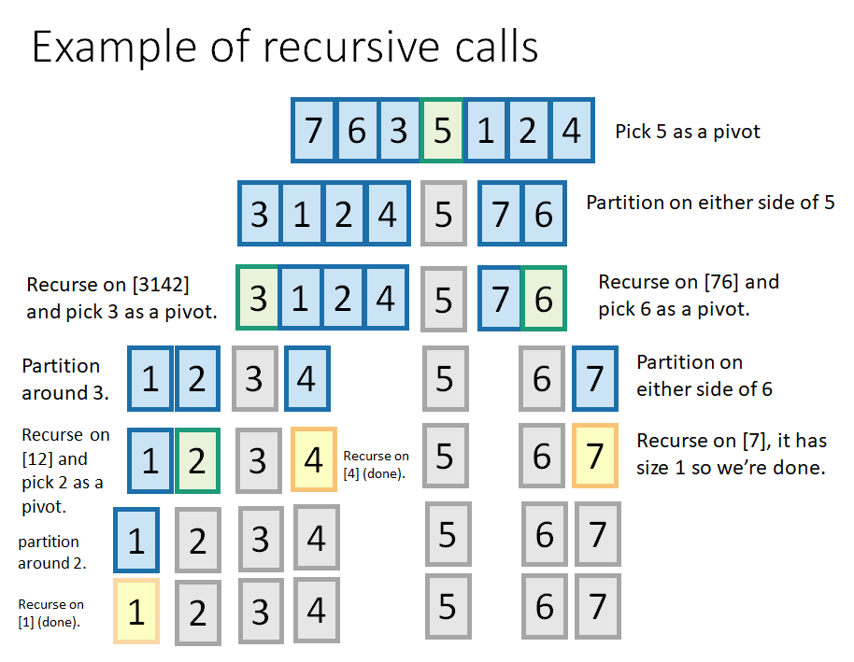

Slide 99
Can partitioning be done in-place?

Slide 100
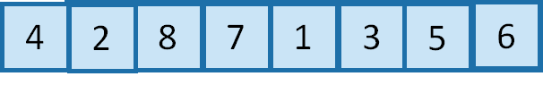

Slide 101
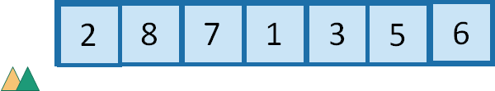
< value
> value

Slide 102
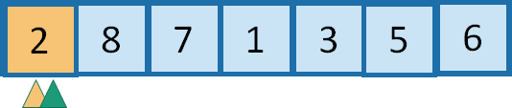

Slide 103


Slide 104


Slide 105


Slide 106


Slide 107


Slide 108


Slide 109


Slide 110


Slide 111


Slide 112

Lomuto’s partitioning: O(n) time, in place

Slide 113
def qsort(l, start, end):
if start >= end:
return
#Pick a random element as pivot
randindex = random.randint(start, end)
(l[randindex],l[start]) = (l[start],l[randindex])
pivot = l[start]
smaller = start
bigger = start
for bigger in range(start+1, end+1):
if l[bigger] <= pivot:
smaller += 1
(l[smaller],l[bigger]) = (l[bigger],l[smaller])
#Place pivot in the right spot
(l[start],l[smaller]) = (l[smaller],l[start])
qsort(l, start, smaller - 1)
qsort(l, smaller + 1, end)
def quicksort(a):
qsort(a,0,len(a)-1)

Slide 114

< value
> value

Slide 115


Slide 116


Slide 117


Slide 118


Slide 119


Slide 120


Slide 121


Slide 122


Slide 123


Slide 124


Slide 125


Slide 126

Hoare’s partitioning: O(n) time, in place

Slide 127

Tony Hoare (Quicksort, 1959)
ACM Turing Award 1980

Slide 128

John von Neumann (Mergesort, 1945)

Slide 129
Running time of Quicksort = ?
L
x
R
< value
value
> value
It depends on the sizes of the two partitions. If the pivot was the ith smallest element,
T(n) = T(i-1) + T(n-i) + cn
Best-case = ?
Worst-case = ?

Slide 130
Running time of Quicksort = ?
L
x
R
< value
value
> value
It depends on the sizes of the two partitions. If the pivot was the ith smallest element,
T(n) = T(i-1) + T(n-i) + cn
Best-case = Partition splits the numbers evenly, and we get a similar recursion as mergesort.
Worst-case = ?

Slide 131
Running time of Quicksort = ?
L
x
R
< value
value
> value
It depends on the sizes of the two partitions. If the pivot was the ith smallest element,
T(n) = T(i-1) + T(n-i) + cn
Best-case = Partition splits the numbers evenly, and we get a similar recursion as mergesort.
Worst-case = One partition empty, the other has all the elements. We get a similar recursion as insertion sort.

Slide 132
Running time of Quicksort = ?
L
x
R
< value
value
> value
It depends on the sizes of the two partitions. If the pivot was the ith smallest element,
T(n) = T(i-1) + T(n-i) + cn
Best-case = O(n log n)
Worst-case = O(n²)

Slide 133
What about average case?
Let T(n) = Expected number of operations needed to quicksort n numbers
During partitioning, we would pick the i^{th} smallest element as the pivot, with probability 1/n.
T(n) = 1/n ∑ [T(i-1) + T(n-i) + cn]
This simplifies to
T(n) = O(n log n)
n
i = 1

Slide 134
Running time of Quicksort = ?
L
x
R
< value
value
> value
It depends on the sizes of the two partitions. If the pivot was the ith smallest element,
T(n) = T(i-1) + T(n-i) + cn
Best-case & Average case = O(n log n)
Worst-case = O(n²)

Slide 135
Merge sort vs Quick sort
Merge Sort is O(n log n) for best, average and worst case
Quick Sort is O(n log n) for best & average case, but O(n²) worst-case
But Quick Sort is also in-place, which Merge Sort is not. (although call stack space in Quicksort should also be noted)

Slide 136

If Randomized Quicksort is implemented well, it is more likely that your computer will be struck by a lightning bolt than the Quicksort running in O(n²) time.

Slide 137
Merge sort vs Quick sort
Merge Sort is O(n log n) for best, average and worst case
Quick Sort is O(n log n) for best & average case, but O(n²) worst-case
Quick Sort runs faster in empirical analysis.
Quick Sort is also in-place, which Merge Sort is not.
But Merge Sort does have one advantage: stability

Slide 138


Slide 139

A stable sort preserves the relative order of items with equal keys.

Slide 140

Selection Sort is not stable

Slide 141

Insertion Sort is stable
What about bubble sort?

Slide 142

Merge Sort is stable. Why?
And what about Quick Sort?

Slide 143
Merge sort vs Quick sort
Merge Sort is O(n log n) for best, average and worst case
Quick Sort is O(n log n) for best & average case, but O(n²) worst-case
Quick Sort runs faster in empirical analysis.
Quick Sort is in-place, Merge Sort is not.
Merge Sort is stable, Quick Sort is not.

Slide 144
Java uses Quicksort for primitive types, and Merge Sort (Timsort) for Objects.
Since Merge Sort and Insertion Sort are both stable, Timsort is stable.
Timsort has been Python's standard sorting algorithm since version 2.3.
C++: sort uses quicksort, and stable_sort uses mergesort.

Slide 145

Count the number of inversions in an integer array

Slide 146


Slide 147


Slide 148
Runners numbered from 0 to n-1 race on a straight one-way road to a common finish line. The runners have different (constant) speeds and start at different distances from the finish line. Specifically, runner i has speed s[i] and begins at distance d[i] from the finish line. Each runner stops at the finish line, and the race ends when all the runners have reached the finish line. How many times does one runner pass another?

Slide 149
Design Strategy 4: Transform-and-Conquer
Transform the problem to a different representation (representation change)
Solve the problem.

Slide 150

“That’s the secret to life… replace one worry with another.” (Charles M. Schulz, American cartoonist, the creator of Peanuts)

Slide 151

For example, take the input data and change its representation to a Binary Search Tree.

Slide 152

Tree Sort
An inorder traversal of such a tree would give us the sorted sequence. (But the tree should be balanced)

Slide 153


Slide 154
Back to brute force...
Locate the smallest item and put it in the first place.
Then select the next smallest item and put it in the second place. And so on…
Sorting by repeated selection: “Selection Sort”
Final output ordering generated one by one in sequence.
Locating the smallest item took time O(n) each time… what if we could store the items in a way that allows finding and extracting the min (or max) item to be O(log n)?

Slide 155
Requirement for a new Abstract Data Type (ADT)
A specification of (1) what the data is, and (2) the operations that will be performed on the data.
It describes the interface the user of the ADT will see, not how it would be implemented under the hood. There can be different under-the-hood implementations of the same ADT.
For example, a Stack ADT can be implemented either using a dynamic array (Vector) or a linked list. Similarly for a queue ADT. The ADT description only mentions the operations (push, pop) and their semantics (LIFO behavior for stack, and FIFO behavior for queue)

Slide 156
Priority Queue ADT
In our case, we need to take the elements that we want to sort, and insert them into an ADT, and be able to extract the minimum element from the ADT repeatedly.
So the two relevant operations we want are (1) insert, and (2) extract-minimum. The data itself can be assumed to be simple integers, or it could be any type of object for which there is a well-defined key field for comparison operation (that tells us whether object 1 is <, = or > object 2).
A priority queue ADT supports these operations.

Slide 157

They just differ in whether higher priority means a smaller value or a larger value.

Slide 158


Slide 159


Slide 160


Slide 161


Slide 162


Slide 163


Slide 164


Slide 165
Priority Queue ADT isn’t just to help in sorting
If we want to keep track of patients in an ER to determine in what order to serve them, we need a priority queue for them, with insert and extract-max operations. (Perhaps a change-priority operation also?)
If want a printer to keep track of printing jobs with different priorities, or an operating system to keep track of processes with different priorities, we again need the same operations - insert, extract-max.
So even though we are covering priority queues in the context of the sorting problem, do keep in mind that they are used for many other problems.

Slide 166
Data structure
How the ADT is implemented under-the-hood.
The Priority Queue ADT can be implemented as a
Unsorted array
Sorted array
Unsorted list
Sorted list
How much time does insert and extract-max take for each option?

Slide 167
Implementation of Priority Queue ADT
We want an implementation that can do both insert and extract-max/min in O(log n) time. Only then can we get an overall O(n log n) sort.
Since the height of a complete binary tree with n elements is log n (why?), it makes sense to think of a structure like that under-the-hood.
And since the only element directly accessible for a binary tree is its root, it makes sense to somehow have the item with the highest priority at the root.
A binary heap is the most popular data structure that can do this.
Note that BSTs can also be used (as we briefly saw in tree sort) but binary heaps would be more efficient, as we can implement them using arrays instead of explicit tree nodes with pointers.

Slide 168

Priority of any node >= Priority of its children.

Slide 169


Slide 170


Slide 171
Max possible height of an n node heap?

Slide 172
Max possible height of an n node heap?
O(log n)

Slide 173


Slide 174

Notes:
parent(i) = i/2
Children of i = 2i, 2i + 1 provided they don’t exceed max_elements

Slide 175


Slide 176


Slide 177


Slide 178


Slide 179


Slide 180


Slide 181


Slide 182


Slide 183


Slide 184


Slide 185


Slide 186


Slide 187


Slide 188


Slide 189


Slide 190


Slide 191


Slide 192


Slide 193


Slide 194


Slide 195


Slide 196


Slide 197


Slide 198


Slide 199


Slide 200
How do we build a heap in time better than O(n log n)?

Slide 201


Slide 202


Slide 203


Slide 204


Slide 205


Slide 206


Slide 207


Slide 208


Slide 209


Slide 210


Slide 211


Slide 212


Slide 213


Slide 214


Slide 215


Slide 216

Time complexity = ?

Slide 223
Heap Sort can be done in place.
In O(n log n) worst-case time.

Slide 224
Heap Sort can be done in place.
In O(n log n) worst-case time.
But it is not stable. Why?

Slide 225
Heap Sort can be done in place.
In O(n log n) worst-case time.
But it is not stable.
Cache performance also not good. Why?

Slide 226
#MAXHEAP
class PriorityQueue:
def __init__(self):
self.A = ['SENTINEL']
self.size = 0
def parent(self, i): #Index of parent for node i
if i >= 1 and i <= self.size:
return i / 2
else:
return -1 #There is no parent
def leftchild(self, i):
if i >= 1 and 2*i <= self.size:
return 2*i
else:
return -1
def rightchild(self, i):
if i >= 1 and 2*i+1 <= self.size:
return 2*i + 1
else:
return -1

Slide 227
def insert(self, key):
self.A.append(key)
self.size += 1
curr = self.size #index of the element right now as it is being bubbled up
while self.parent(curr) != -1 and self.A[self.parent(curr)] < self.A[curr]:
(self.A[self.parent(curr)],self.A[curr]) = (self.A[curr],self.A[self.parent(curr)])
curr = self.parent(curr)
def sink(self,i):
if i < 1 or i > self.size:
return
left = self.leftchild(i)
right = self.rightchild(i)
if left == -1:
return
if right == -1:
largerchild = left
else:
if self.A[left] > self.A[right]:
largerchild = left
else:
largerchild = right
if self.A[i] < self.A[largerchild]:
#swap the two to sink the heavier element down
(self.A[i],self.A[largerchild]) = (self.A[largerchild],self.A[i])
self.sink(largerchild)

Slide 228
def extractmax(self):
if self.size == 0:
return None
#Swap the top element with the last element
(self.A[1],self.A[self.size]) = (self.A[self.size],self.A[1])
#Heapify-down the new first element
maxvalue = self.A[self.size]
self.size -= 1
self.sink(1)
return maxvalue
def buildheap(self,array):
if self.size != 0:
return
self.A.extend(array)
print len(self.A)
self.size = len(self.A) - 1
for i in range(self.size,0,-1):
self.sink(i)
def heapsort(self):
if self.size == 0:
return
numelements = self.size
for i in range(numelements): #Do as many deletions as number of elements
self.extractmax()
return self.A[1:numelements+1]

Slide 229
What if we want to search for an element in a binary heap?
Notes:
It will take O(n) time

Slide 230
Lower bound on worst-case complexity of sorting
All the algorithms we have seen use comparison operations.
If we can get a lower bound on just comparison operations, that would also be a lower bound on the entire algorithm.
Construct a decision tree for visualising the execution of a sorting algorithm. - Internal nodes are comparisons, which yield a binary yes/no decision - Leaf nodes represent the found answers - The execution of an algorithm represented by a path from root to leaf - The path length is the running time. - Height of the tree is the worst-case running time

Slide 231


Slide 232
Comparison-based sorting: Worst-case Ω(n log n)

Slide 233

Sorting an array with many entries of ‘small’ values
You are given an array of student objects. Each student has an integer-valued age field that is to be treated as a key. Rearrange the elements of the array so that the ages appear in sorted order.

Slide 234

Just count how many students of each age there are!

Slide 235




Slide 236
Time complexity = ?
Assume there are n integers in the range {0,1,2...,k-1}
How much extra space is needed?
What if we want to keep the sort stable?

Slide 237

Radix Sort
n integers, d digits, in some base (base-10 in the example)

Slide 238


Slide 239


Slide 240


Slide 241


Slide 242


Slide 243


Slide 244


Slide 245


Slide 246


Slide 247


Slide 248
“I think the bubble sort is the wrong way to go”

Slide 249


https://www.quora.com/What-is-the-most-efficient-way-to-sort-a-million-32-bit-integers

Slide 250
COW DOG SEA RUG ROW MOB BOX TAB
BAR EAR TAR DIG BIG TEA NOW FOX

Slide 251
Bucket Sort
Divides the entire range of values into a set of buckets.
Generalization of Counting Sort (where bucket size = 1)
Steps -
Set up an array of initially empty "buckets".
Scatter: Go over the original array, putting each object in its bucket.
Sort each non-empty bucket.
Gather: Visit the buckets in order and put all elements back into the original array.

Slide 252
Sorting Live Class

Slide 253
Problem-solving
Problems are not exercises.
Exercise: 3456789 X 43289763 = ?
It is hard, but there is no doubt what method to use.
A problem is a question for which you have no idea (at least initially) what method will work. You will feel clueless at the beginning.
It requires sustained investigation, deploying strategies.
Mathematical problems, scientific problems, and computational problems.

Slide 254
Ideal interview
An algorithm is the method to solve a computational problem.
Implemented as a program.
Can you design a correct and efficient algorithm that solves the problem, and code it up?

Slide 255

“But the interview is a timed test!”
The fact is that the ideal interview process is broken in many companies. How do we tackle the tension between problem-solving (which needs time) and a severe time limit?
Mug up solutions to all 1200+ Leetcode questions and hope every question you will face will be an exercise?
Become a problem-solver and develop inner confidence, while getting exposed to popular interview questions?

Slide 256
At IK, you should be learning problem-solving (for new problems) and coding fluency (for exercises)
Learn to tackle questions you have not seen before. Be prepared for the worst-case.
We will be giving you popular interview questions as problems. Avoid looking up solutions and train yourself to become a problem-solver when you see a new question.
Many popular interview questions (problems) will become exercises. But do not forget the problem-solving path you followed to first solve it.
Once a problem has become an exercise, try to improve your coding fluency on it.

Slide 257

Is this a problem or an exercise?
How fast can you code this up?

Slide 258


Slide 259


Slide 260


Slide 261
Problem-solving mindset
Mental discipline: Long, wild-goose chases and open-ended experimentation. - Timescale of concentration required needs to increase. - Failure: Investigation is always worthwhile even if it leads to a dead-end.
Emotional attitude: Mountaineer vs Gym rat “The explorer is the person who is lost”
Art and a craft
Build background (playground) knowledge
Learn how other people solved problems
Active engagement

Slide 262
Two sum
You have an array of n numbers and a number target. Find out whether the array contains two elements whose sum is target.
For example, for the array [5, 9, 1, 3] and target = 6, the answer is yes.
For the same array and target = 7, the answer is no.

Slide 263


Slide 264


Slide 265
Intersection of two sorted arrays
Write a program that takes as input two sorted arrays, and returns a new array containing elements that are present in both of the input arrays.
The input arrays may have duplicate entries, but the returned array should be free of duplicates.
For example, if the input is A1 = [2,3,3,5,5,6,7,7,8,12] A2 = [5,5,6,8,8,9,10,10] the output should be [5,6,8]

Slide 266
#What if arrays are of similar sizes? What if they are of very different sizes?
def intersect(a1,a2):
i = 0
j = 0
aux = []
while i < len(a1) and j < len(a2):
if a1[i] < a2[j]:
i += 1
elif a1[i] > a2[j]:
j += 1
else: #a1[i] == a2[j]
if len(aux) == 0 or aux[len(aux)-1] != a1[i]:
aux.append(a1[i])
i += 1
j += 1
return aux
a1 = [2,3,3,5,5,6,7,7,8,12]
a2 = [5,5,6,8,8,9,10,10]

Slide 267


Slide 268


Slide 269


Slide 270


Slide 271


Slide 272


Slide 273
import random
def quickselect(A,k):
if len(A) == 0 or (k-1 < 0) or (k-1 >= len(A)):
print "Invalid input"
else:
return quickselecthelper(A,k,0,len(A)-1)
def quickselecthelper(A,k,start,end):
if start == end: #One element subarray
if start != k-1:
print "There is some error here"
else:
return A[k-1]
#Pick a random element as pivot
randindex = random.randint(start, end)
(A[start],A[randindex]) = (A[randindex],A[start])
pivot = A[start]
smaller = start
bigger = start
for bigger in range(start+1,end+1):
if A[bigger] <= pivot:
smaller += 1
(A[smaller],A[bigger]) = (A[bigger],A[smaller])
#Now place pivot in the right spot
(A[start],A[smaller]) = (A[smaller],A[start])
if k-1 == smaller:
return A[k-1]
elif k-1 < smaller:
return quickselecthelper(A,k,start,smaller-1)
else:
return quickselecthelper(A,k,smaller+1,end)

Slide 274
Best case?
Worst case?
Average case?

Slide 275


Slide 276


Slide 277


Slide 278
Write a program that takes a sequence of strings in “streaming” fashion, and computes the k longest strings in the sequence.
Time complexity after seeing n strings = ?

Slide 279
Write a program that takes a sequence of strings in “streaming” fashion, and computes the k longest strings in the sequence.
minheap = []
for s in sequence:
minheap.insert(s,priority=len(s)) if len(minheap) > k: minheap.extractmin()
//minheap always maintains the k longest strings at any time

Slide 280


Slide 281
A heap is a good choice when you are maintaining the k largest or k smallest elements in any collection.
But what about the median finding problem?

Slide 282
Compute the Median of Online data
Compute the running median of a sequence of numbers. The sequence is presented to you in a streaming fashion - you cannot back up to read an earlier value, and you need to output the median after reading in each new element.
Example input: 1,0,3,5,2,0,1
Output: 1, 0.5, 1, 2, 2, 1.5, 1

Slide 283


Slide 284


Slide 285


Slide 286
Sort Big File
Imagine you have a 200 GB file with one string per line. Explain how you would sort the file.
You cannot bring all the data into memory.

Slide 287

Two-way external merge sort with 3 buffers

Slide 288


Slide 289


Slide 290


Slide 291


Slide 292

Number of passes in k-way External Merge Sort

Slide 293


Slide 294


Slide 295


Slide 296


Slide 297


